Slide 1
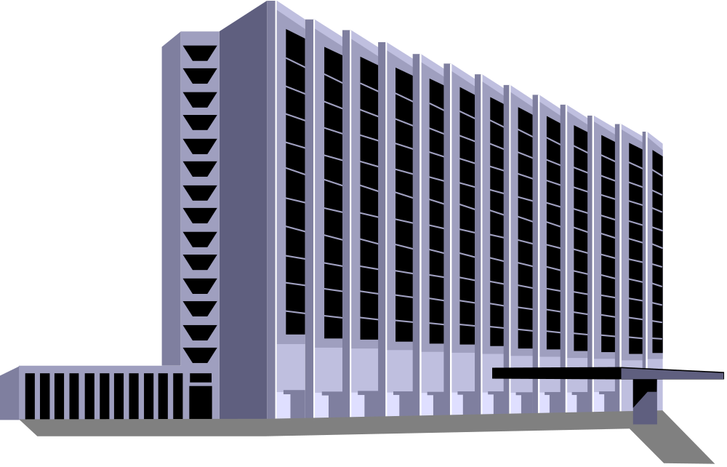

Capital structure Decision /
Financing Decision
How do we want to finance our firm’s assets?
Notes:
1

Slide 2
Balance Sheet
Current Current
Assets Liabilities
Debt and
Fixed Preferred
Assets
Shareholders’
Equity
Notes:
2

Slide 3
Balance Sheet
Current Current
Assets Liabilities
Debt and
Fixed Preferred
Assets
Shareholders’
Equity
Notes:
3

Slide 4
Balance Sheet
Current Current
Assets Liabilities
Debt and
Fixed Preferred
Assets
Shareholders’
Equity
Financial
Structure
Notes:
4

Slide 5
Balance Sheet
Current Current
Assets Liabilities
Debt and
Fixed Preferred
Assets
Shareholders’
Equity
Notes:
5

Slide 6
Balance Sheet
Current Current
Assets Liabilities
Debt and
Fixed Preferred
Assets
Shareholders’
Equity
Capital
Structure
Notes:
6

Slide 7
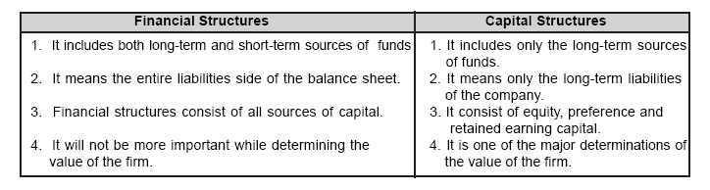

Slide 8

Why is Capital Structure Important?
1) Leverage: higher financial leverage means higher returns to stockholders, but higher risk due to interest payments.
2) Cost of Capital: Each source of financing has a different cost. Capital structure affects the cost of capital.
3) The Optimal Capital Structure is the one that minimizes the firm’s cost of capital and maximizes firm value.

Slide 9
OPTIMUM CAPITAL STRUCTURE
Optimum capital structure is the capital structure at which the weighted average cost of capital is minimum and thereby the value of the firm is maximum.
Optimum capital structure may be defined as the capital structure or combination of debt and equity, that leads to the maximum value of the firm.

Slide 10
Objectives of Capital Structure
Maximize the value of the firm.
Minimize the overall cost of capital.

Slide 11
Capital Structure Theories
There is a relationship among the capital structure, cost of capital and value of the firm.
The aim of effective capital structure is to maximize the value of the firm and to reduce the cost of capital.
There are three major theories explaining the relationship between capital structure, cost of capital and value of the firm.

Slide 12
Net Income (NI) Approach
suggested by the Durand.
The capital structure decision is relevant to the valuation of the firm. In other words, a change in the capital structure leads to a corresponding change in the overall cost of capital as well as the total value of the firm.
According to this approach, use more debt finance to reduce the overall cost of capital and increase the value of firm.
Net income approach is based on the following three important assumptions:
1. There are no corporate taxes.
2. The cost debt is less than the cost of equity.
3. The use of debt does not change the risk perception of the investor.

Slide 13

Net Income Approach
The low cost of debt
reduces the cost of
capital.
ke
Cost of
Capital
kc
ko
kd
kd
financial leverage (Degree of leverage)
Notes:
27

Slide 14
Net Operating Income (NOI) Approach
Capital Structure decision is irrelevant to the valuation of the firm.
The market value of the firm is not at all affected by the capital structure changes.
According to this approach, the change in capital structure will not lead to any change in the total value of the firm and market price of shares as well as the overall cost of capital.
NOI approach is based on the following important assumptions;
The overall cost of capital remains constant;
There are no corporate taxes;

Slide 15

NOI approach
The cost of capital does
not change. Leverage has
no effect on the cost
of capital and
therefore,
ke
Cost of
Capital
it has no effect on
the value of the firm.
kc
ko
kd
kd
financial leverage
Notes:
20

Slide 16
Modigliani and Miller Approach
Modigliani and Miller approach states that the financing decision of a firm does not affect the market value of a firm in a perfect capital market.
In other words MM approach maintains that the average cost of capital does not change with change in the debt weighted equity mix or capital structures of the firm.

Slide 17
Modigliani and Miller approach is based on the following important assumptions:
• There is a perfect capital market.
• There are no retained earnings.
• There are no corporate taxes.
• The investors act rationally.
• The dividend payout ratio is 100%.
• The business consists of the same level of business risk.

Slide 18

Capital Structure Management
EBIT-EPS Analysis - used to help determine whether it would be better to finance a project with debt or equity.
EPS = (EBIT - I)(1 - t) - P
S
Notes:
45

Slide 19
Capital Structure Management
EBIT-EPS Analysis - used to help determine whether it would be better to finance a project with debt or equity.
EPS = (EBIT - I)(1 - t) - P
S
I = interest expense, P = preferred dividends,
S = number of shares of common stock
outstanding.
Notes:
46

Slide 20

EBIT-EPS Example
A firm has 8,00,000 shares of common stock outstanding, no debt, and a marginal tax rate of 40%. A further need Rs. 60,00,000 to finance a proposed project. The firm considering two options to procure the amount:
1. Sell 2,00,000 shares of common stock at Rs.30 per share,
2. Borrow Rs.6,000,000 by issuing 10% bonds.
Cont…..
Notes:
47

Slide 21

If the firm expect EBIT to be Rs.20,00,000:
Financing stock debt
EBIT 2,000,000 2,000,000
- interest 0 (600,000)
EBT 2,000,000 1,400,000
- taxes (40%) (800,000) (560,000)
EAT 1,200,000 840,000
# shares outst. 1,000,000 800,000
EPS Rs.1.20 Rs.1.05
Notes:
48

Slide 22
If the firm expect EBIT to be Rs.40,00,000:
Financing stock debt
EBIT 4,000,000 4,000,000
- interest 0 (600,000)
EBT 4,000,000 3,400,000
- taxes (40%) (1,600,000) (1,360,000)
EAT 2,400,000 2,040,000
# shares outst. 1,000,000 800,000
EPS Rs.2.40 Rs.2.55
Notes:
49

Slide 23
If the EBIT is Rs.2,000,000, common stock financing is best.
If the EBIT is Rs.4,000,000, debt financing is best.
So, now we need to find a breakeven EBIT where neither is better than the other.
Notes:
50

Slide 24

If we choose stock financing:
EPS
3
stock
financing
2
1
0
EBIT
1m 2m 3m 4m
Notes:
51

Slide 25

If we choose
bond financing:
bond
financing
EPS
3
2
1
0
EBIT
1m 2m 3m 4m
Notes:
52

Slide 26

Breakeven EBIT
bond
financing
EPS
3
stock
financing
2
1
0
EBIT
1m 2m 3m 4m
Notes:
53

Slide 27

Breakeven Point:
Set 2 EPS calculations equal to each other and solve for EBIT:
Stock Financing Debt Financing
(EBIT-I)(1-t) - P = (EBIT-I)(1-t) - P
S S
Notes:
54

Slide 28
Breakeven Point:
Stock Financing Debt Financing
(EBIT-I)(1-t) - P = (EBIT-I)(1-t) - P
S S
(EBIT-0) (1-.40) = (EBIT-600,000)(1-.40)
800,000+200,000 800,000
Notes:
55

Slide 29

To refresh your algebra….
Stock Financing Debt Financing
.6 EBIT = .6 EBIT - 360,000
1 .8
.48 EBIT = .6 EBIT - 360,000
.12 EBIT = 360,000
EBIT = 30,00,000
Notes:
55

Slide 30
Breakeven EBIT
bond
financing
EPS
3
For EBIT up to 3 million,
stock financing is best.
stock
financing
2
1
0
EBIT
1m 2m 3m 4m
Notes:
56

Slide 31
Breakeven EBIT
bond
financing
EPS
3
For EBIT up to Rs. 3 million,
stock financing is best.
stock
financing
2
For EBIT greater
than 3 million,
debt financing is
best.
1
0
EBIT
1m 2m 3m 4m
Notes:
57

Slide 32

Ex: Problem
Plan A- all equity: We will start a new firm by selling 12,00,000 shares at Rs.10 per share.
Plan B- levered: issue Rs. 3.5 million in 9% debt and finance the rest with equity at Rs.10 per share.
Notes:
58

Slide 33
a) Breakeven EBIT:
Stock Financing Levered Financing
(EBIT-I) (1-t) - P = (EBIT-I) (1-t) - P
S S
EBIT-0 (1-.50) = (EBIT-315,000)(1-.50)
1,200,000 850,000
EBIT = Rs.10,80,000
Notes:
59

Slide 34

Analytical Income Statement
Stock Levered
EBIT 1,080,000 1,080,000
I 0 (315,000)
EBT 1,080,000 765,000
Tax (540,000) (382,500)
NI 540,000 382,500
Shares 1,200,000 850,000
EPS .45 .45
Notes:
60

Slide 35

b) Breakeven EBIT
levered
financing
EPS
stock
financing
.65
.45
.25
0
EBIT
.5m 1m 1.5m 2m
Notes:
61

Slide 36
For EBIT up to 1.08 m,
stock financing is best.
Breakeven EBIT
levered
financing
EPS
stock
financing
.65
.45
.25
0
EBIT
$.5m $1m $1.5m $2m
Notes:
62

Slide 37
For EBIT up to $1.08 m,
stock financing is best.
Breakeven EBIT
levered
financing
EPS
stock
financing
.65
For EBIT greater
than 1.08 m,
the levered plan is
best.
.45
.25
0
EBIT
$.5m $1m $1.5m $2m
Notes:
63

Slide 38
EMCOR Products has a present capital structure consisting only of common stock (10 Lakh shares). The company is planning a major expansion with an expected EBIT of Rs 10 Lakhs. At this time, the company is undecided between the following two financing plans (assume a 40 percent marginal tax rate):
Plan 1: (Equity financing). Under this plan, an additional 5 Lakh shares of common stock will be sold at Rs10 each.
Plan 2: (Debt financing). Under this plan, Rs50 Lakh of 10 percent long term debt will be sold.
Calculate the EBIT-EPS indifference point.

